Slide 2
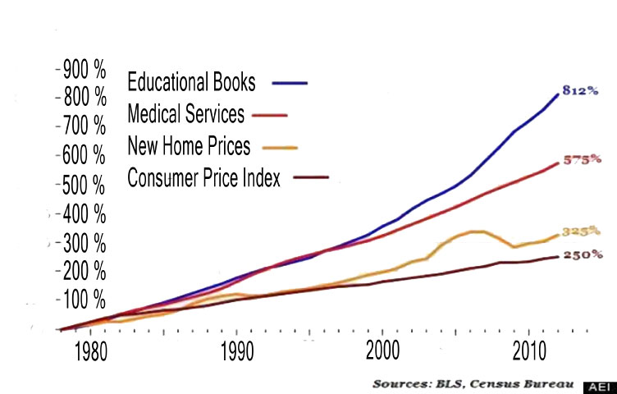
Textbook Costs Rise 6% Annually
http://www.slideshare.net/UnaDaly/reducing-costs-for-ict-majors-with-the-california-affordability-textbook-act-2015-56835222

Slide 3
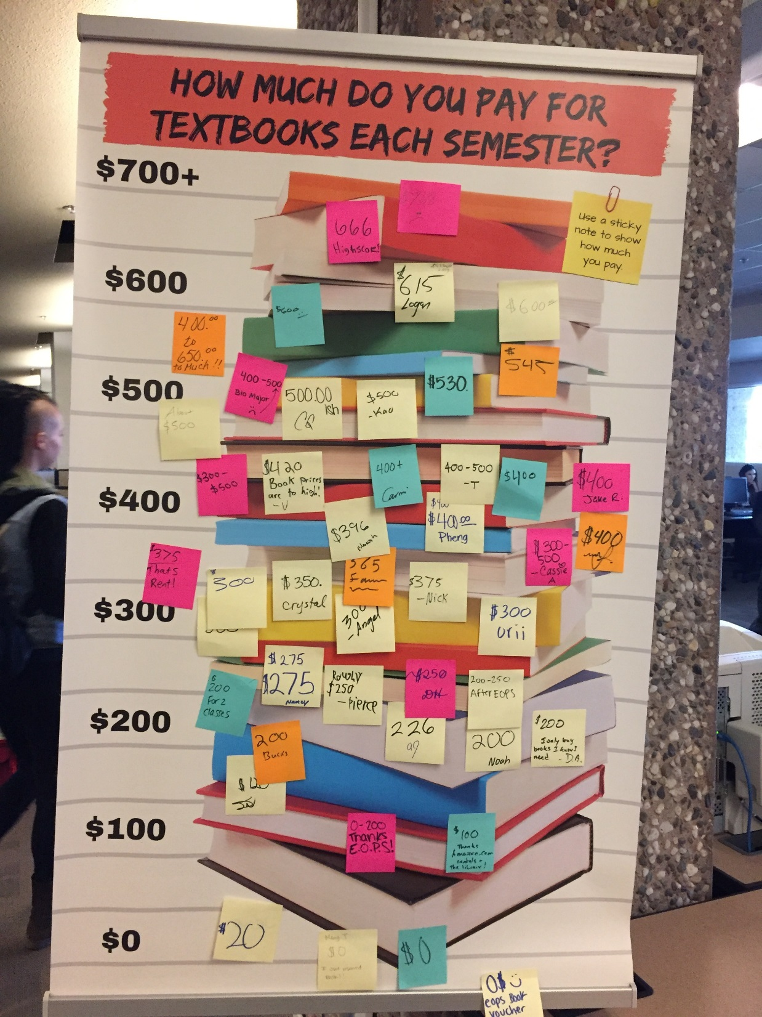

Slide 4
Butte College: Amount Spent on Textbooks & Materials Per Semester
Nationwide: Cost of Materials Per Unit
Course Materials Fall 2014 | Average Cost of Materials per Unit
1st Gen Students | $ 64.39
Other Students | $ 55.25
http://mfeldstein.com/data-to-back-up-concerns-of-textbook-expenditures-by-first-generation-students/

Slide 5
Student Textbook Survey
Butte Community College 2016
Has the cost of required textbooks ever caused you to do any of the following?
31% | Take fewer classes
27% | Do not register for a specific course
16% | Drop or withdraw from a course
40% | Not purchase textbook
76% | Purchase books elsewhere
22% | Use Reserves in Library
32% | Share Books with friends or classmate
 | Other: Go into debt, Illegally download copy

Slide 6
Student Textbook Survey
Butte Community College 2016
59% | Purchase one or more textbooks per semester that they don’t use
47% | Currently use or would use digital textbooks
51% | Prefer to read on paper
83% | Prefer to keep textbooks in their major
41% | Prefer to keep textbooks in GE courses they find interesting
Cost of textbooks is higher than the cost of tuition

Slide 7
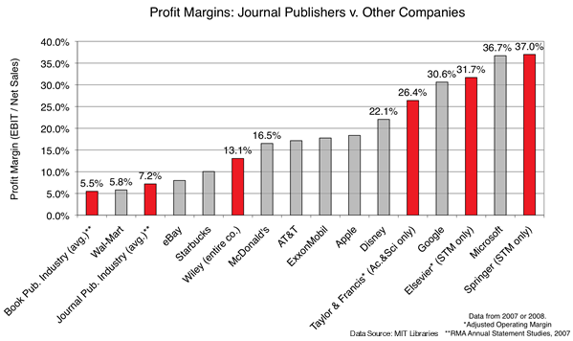
It’s not just textbooks
www.sparc.arl.org

Slide 8
Introduction to Open Educational Resources (OER) by Michael Paskevicius , Learning Technologies Application Developer
License: CC Attribution-ShareAlike License

Slide 9
OER Global Logo by Jonathas Mello is licensed under a Creative Commons Attribution Unported 3.0 License

Slide 10
How aware are you of Open Educational Resources (OER)?
OER is defined as "teaching, learning, and research resources that reside in the public domain or have been released under an intellectual property license that permits their free use and re-purposing by others." Unlike traditionally copyrighted material, these resources are available for "open" use, which means users can edit, modify, customize, and share them.

Slide 11
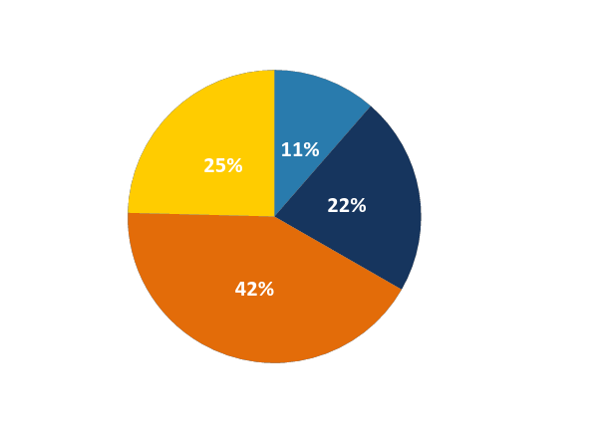
How aware are you of Open Educational Resources (OER)?
Nationwide
Butte College

Slide 12
What are Open Educational Resources?
Open Educational Resources (OERs) are teaching, learning, and research resources released under an open license that permits their free use and repurposing by others. OERs can be textbooks, full courses, lesson plans, videos, tests, software, or any other tool, material, or technique that supports access to knowledge.
Definition from SPARC: the Scholarly Publishing & Academic Resources Coalition

Slide 13
OPEN VS. FREE
© SpiderWeb-MarketingSystems A Banner for Advertising CC BY SA
© FraserElliot Yes, We’re Open CC BY NC
Virginia Library Association Annual Conference
This work is licensed with a Creative Commons Attribution Only License 4.0, unless otherwise noted. Excludes images, illustrations, and logos.

Slide 14
The framework, which will be freely available under a Creative Commons Attribution 4.0 license (CC BY), was designed by Lumen Learning as the 5Rs

Slide 15
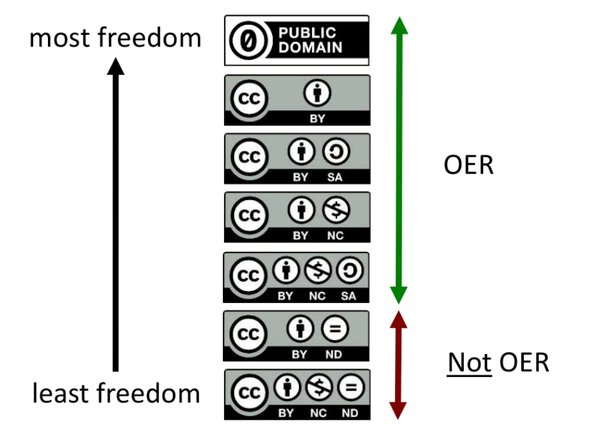
This work by D'Arcy Hutchings is licensed under a Creative Commons Attribution 4.0 International License.

Slide 16
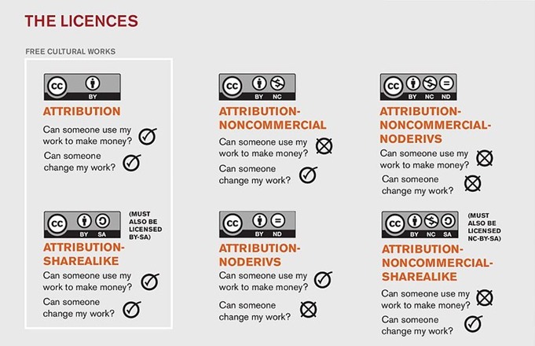
Creative Commons

Slide 17
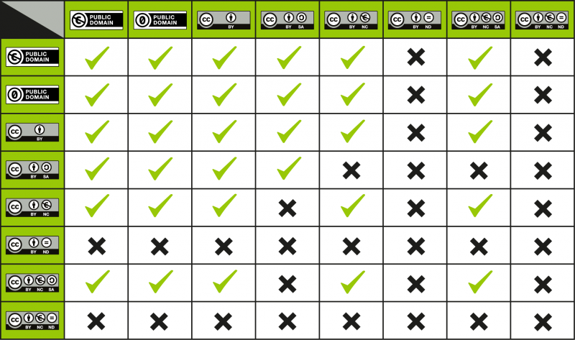
Our Course is CC-BY
License compatibility table by Creative Commons: https://wiki.creativecommons.org/wiki/Wiki/cc_license_compatibility
This wiki is licensed to the public under a Creative Commons Attribution 4.0 license.

Slide 18
Find an Image
What is its licence?
Wikimedia commons
Google
Flicker
Pixabay
Vimeo
https://search.creativecommons.org/
https://open4us.org/find-oer/#Photo/ImageSearch

Slide 19
Attribution
https://wiki.creativecommons.org/wiki/Best_practices_for_attribution
https://commons.wikimedia.org/wiki/File:Sydney_Opera_House,_botanic_gardens_1.jpg

Slide 20
Exam Performance: BC Campus
Traditional vs. Open Print vs. Open Digital
p < 0.05
ns
ns
Notes:
No differences in pre-test, more study time for Trad, more courses taken for Trad, fewer courses taking for Trad

Slide 21
Traditional
Perceptions of the Textbook
Open Print
Open Digital
 | Not at all 1 | 2 | 3 | 4 | 5 | 6 | Very Much 7
Writing is clear
Writing is engaging
Research examples helpful
Everyday examples relevant
Everyday examples helpful
Adequate number of study aids
Helpful study aids
Note: All differences significant at p < .05
Notes:
16 questions asked

Slide 22
TRADITIONAL
OPEN PRINT
OPEN DIGITAL
Traditional
Overall, how would you rate the quality of your textbook?
Open Print
Open Digital
3.54
p < .05
3.90
3.73
1
Very Poor
2
Below Average
3
Average
4
Above Average
5
Excellent
What do you think would be a fair price for your textbook?
Traditional:
$53.51
Note:
Traditional Print costs $100+
Open Print:
$49.90
ns
Open Digital:
$47.68
BC Campus Presentation during CCCOER May 11 Webinar: 3 Faculty Perpectives on OER Adoption
License: CC Attribution License
Notes:
Loose leaf: $95.20 + taxes
50% reported not purchasing a required textbook at least once. (17% rarely, 21% sometimes, 12% often)
Question is really what would you be comfortable spending for this.

Slide 23
More than just free
Can customize to suit your class
Opportunities for collaboration
Curating a book with others
Adding resources to what’s available
Students have access to the book right away
Students can keep it forever
Students have access to current edition now & in the future
Opportunities for lifelong learning & Information literacy
Individually, we are one drop. Together, we are an ocean.
- Ryūnosuke Akutagawa

Slide 24
Survey of faculty using OER for the first time
Butte Community College 2016
12 / 12 | Will likely (3) or certainly (9) use OER again
7 / 11 | Open textbook took the same about of time to prepare.
9 / 12 | OER was easy to integrate into my course
8 / 12 | The use of OER encouraged me to reflect on my teaching practices.
7 / 12 3 / 12 | The OER book was as good as the previous book The OER textbook was better

Slide 25
Survey of Students in OER Classes
Butte Community College 2016
77% | The textbook is easy to use
76% | Used a PDF to read the
25% | Used a printer copy
83% | Would recommend the textbook to other students
88% | This textbook is better than others used in the past
Need more classes to be like this. Simple, easy, and the start of 21st century learning that does not involve hundreds of dollars in physical textbooks.
There were times that the textbook wouldn't download to my computer and I had to return and press download again. But it's way better to get a free textbook than having to buy one.

Slide 26
Survey of Students in OER Classes
Butte Community College 2016
 | OER text | Other text
2 -3 times per week | 47% | 27%
Once per week or never | 24% | 47%
81 – 94% agree that the textbook
met student expectation
helped them learn
was well organized
was readable
had good graphics

Slide 27
OERs can be hard to find
That’s where we can help!
www.tinyurl.com/butteoer

Slide 28
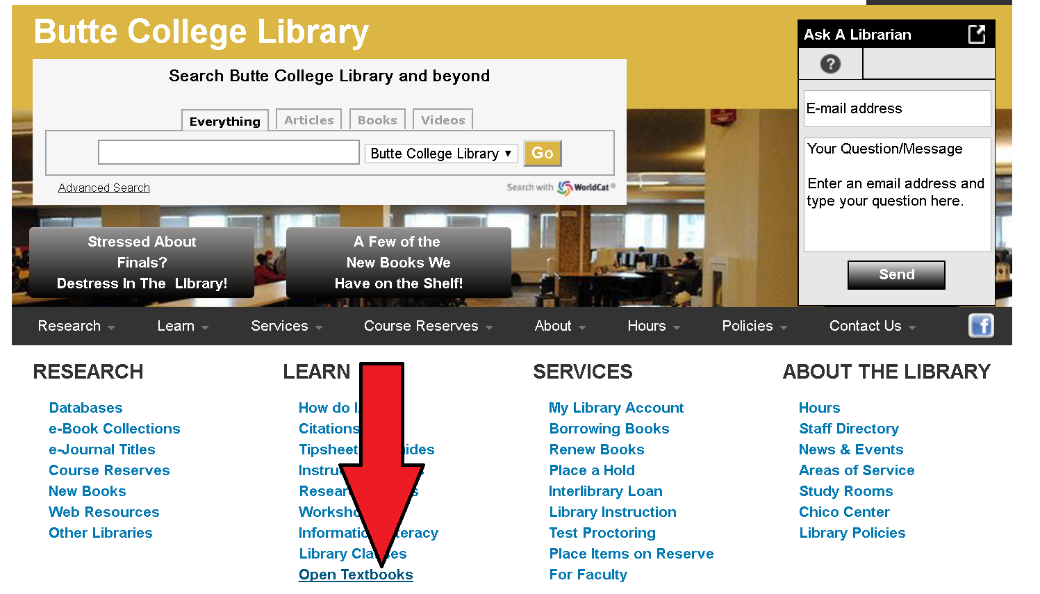
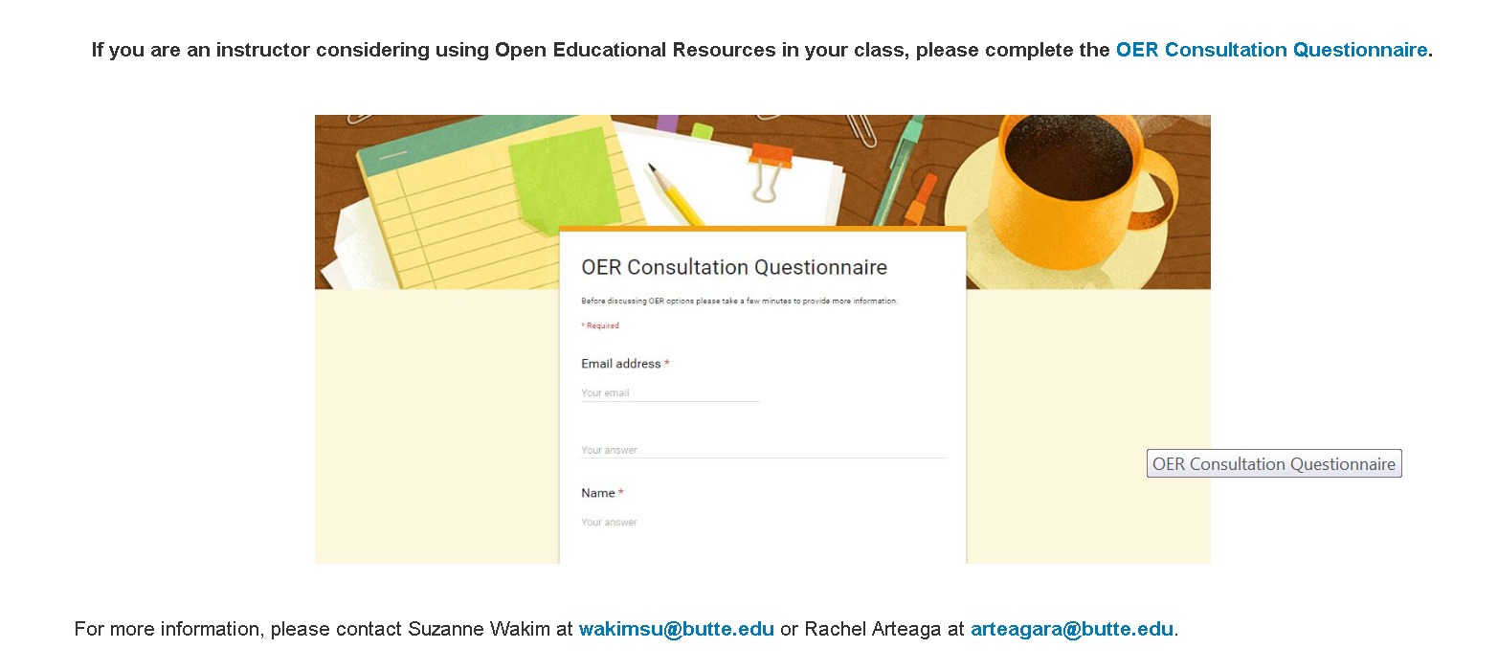

Slide 29
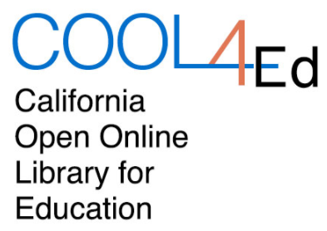
My Favorite Places
Advanced Google Search
OER Commons
COOL4Ed
Open Oregon
Open Textbook Library

Slide 30
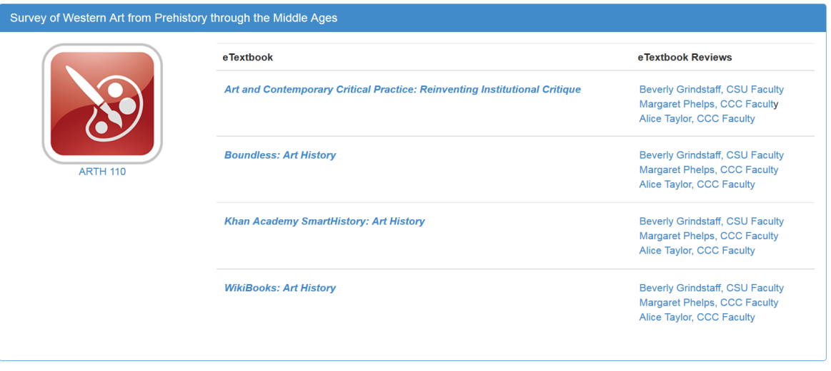

Slide 31
OER Commons
Easy to search and narrow results
Search by discipline
Creation tools available

Slide 32
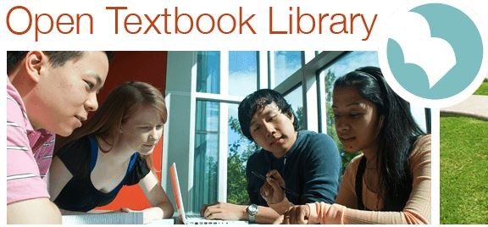
University of Minnesota’s
Open Textbook Library
High quality collection
New books added frequently
Reviews available

Slide 33
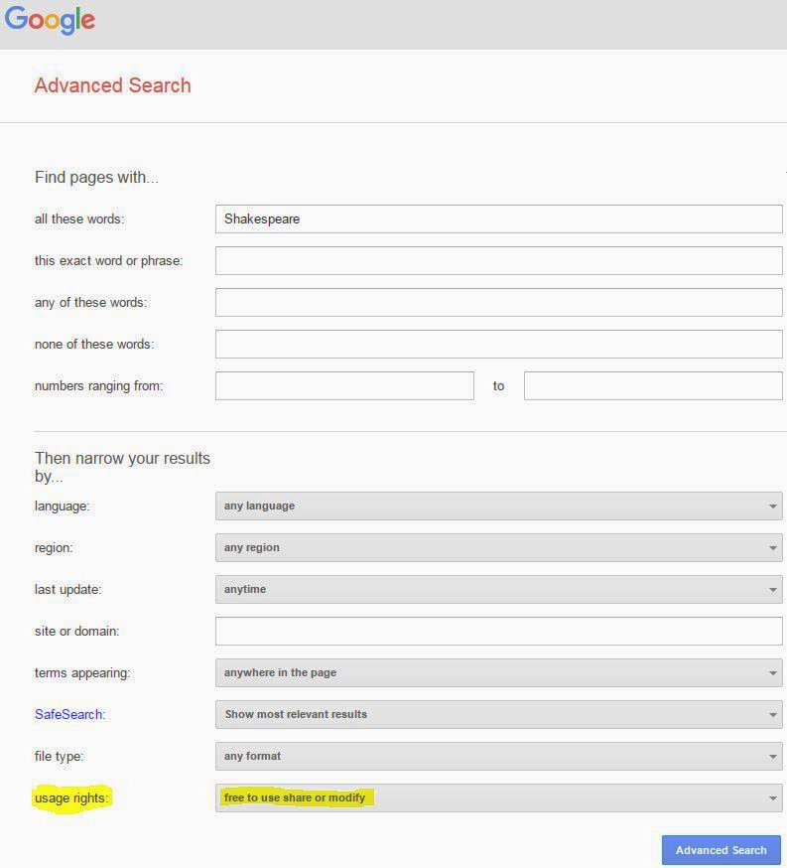
Advanced Search
Go to advanced search (search in Google, look under settings, bottom of page)
Type in keywords
Narrow results by usage rights
Choose “free to use, share, or modify”
You will need to verify license and determine exact terms of use

